Slide 1

AWC Cares
Food Pantry
(John 6:35- “And Jesus said unto them, I am bread of Life: He that cometh to me shall never hunger; and he that believeth on me shall never thirst”)
Presented by Missionary Pamela Thomas

Slide 2
“Our Missions, Visions & Motto”
Mission Statement: “To help the City of Augusta stamp out hunger in the Goshen community one person at a time.”
Vision Statement: To be a blessing to the individual(s) as we will provide food for the natural and feed the spiritual through witnessing.
Our motto: “We Share Because We Care”

Slide 3
The Beginning
Set up a food drive within the church
Seek donations – HIIPAC donated $1,395 on behalf of Bishop Jay’s financial contribution; Amerigroup donated $750 (courtesy of
Exh Matthews)
Post pantry opening on church sign
Visit other pantry’s to observe how they operate
AWC Cares did not partner w/ local food bank-Golden Harvest due to prayer and/or gospel music not allowed while patrons are being served

Slide 4
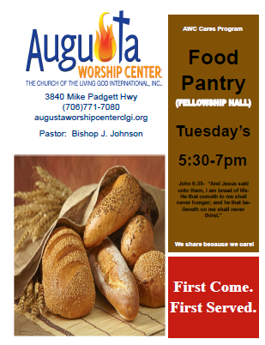
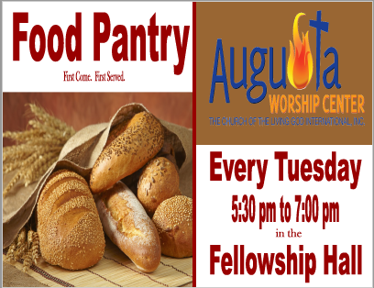
The Beginning
Canvas communities and post fliers

Slide 5
Hours Operation/Staff
Hours of Operation- Tuesday 6pm-7pm (currently every Tuesday)
How to Staff Food Pantry:
  Volunteers from the church are strongly recommended
    Encourage staff and communicate how they are a meaningful part of the ministry
  Staff a minimum of 4 volunteer
    Package food- 2-3 volunteers; assist w/ signing in visitors- 1 volunteer; a runner- 1 volunteer
  Consider security during hours of operation

Slide 6
Setup
Food storage Shelves- 6 in. off floor; 4 in. from the wall; 2 ft from the ceiling
  Maintain a cool, clean dry place for storing food
  Food in a secure facility
Inspect food for dents, punctures, expired date, no date, leaks

Slide 7
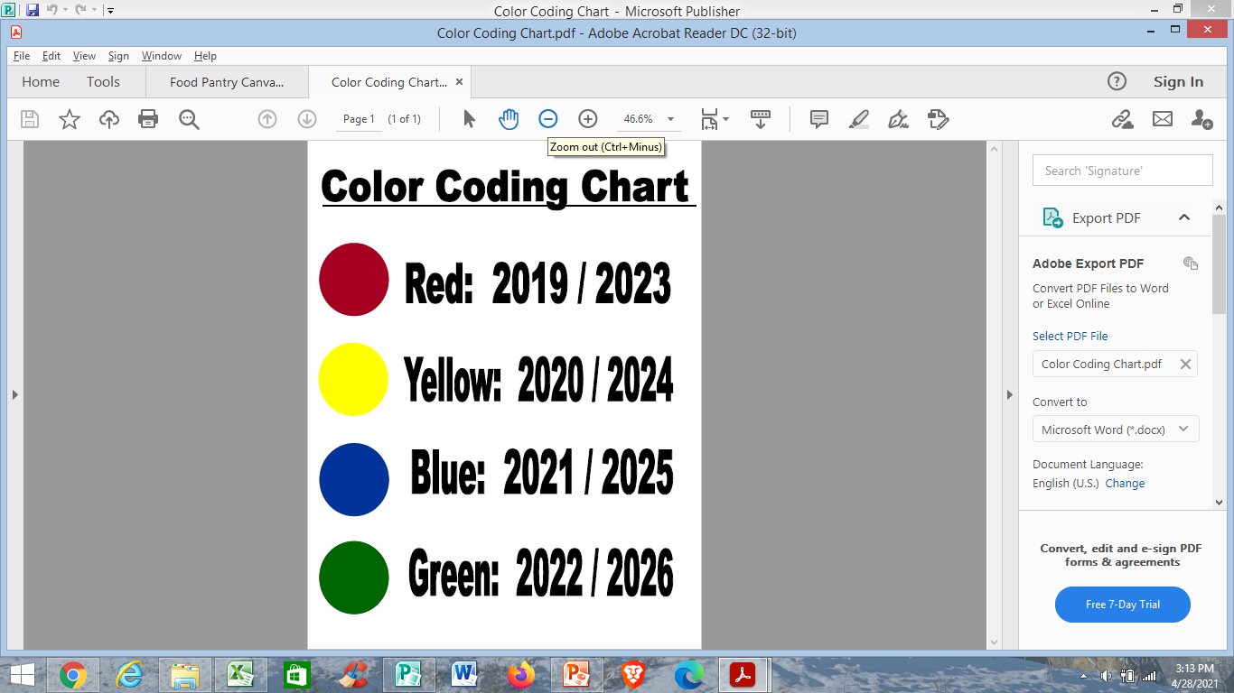
Setup cont. – Food Labeling
Label food w/ expiration date for
easy visibility so food can
be rotated first in, first out.

Slide 8
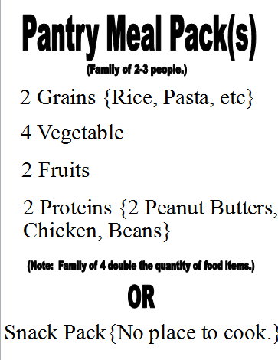
Setup cont. – Meal Serving
Meal Servings
2 Grains {Rice, Pasta, etc.}
4 Vegetables
2 Fruits
2 Proteins {Peanut Butter,
Chicken, Beans}
*For family 2-3 people. If there is
4+ family members, double the
amount of food.

Slide 9
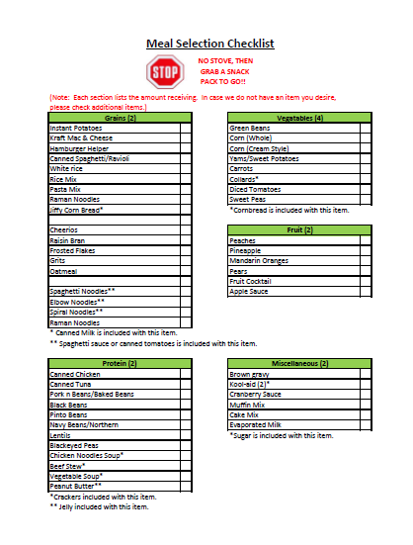
Set up cont – Meal Selection
A meal selection sheet is provided
to visitors to select items they prefer.
(Note: Customers selecting their items
decreases food waste.)
Don’t assume everyone is able to read
Consider those without a stove
  Offer a snack pack—food that does not
  require cooking (i.e. flip top can goods, crackers,
  a drink, and etc.)

Slide 10
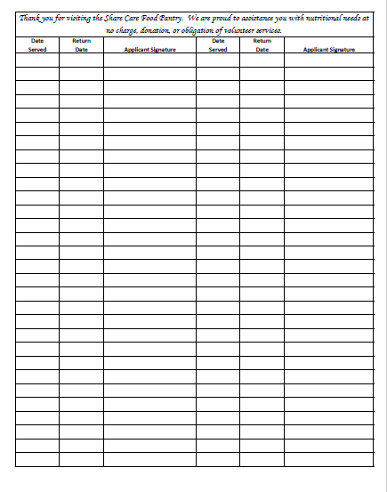
Set up cont. – Visitor’s Log
Clients will be able to receive
food every 4 weeks. This will be
monitored by keeping a record
of the dates the visitor come
to the pantry.

Slide 11
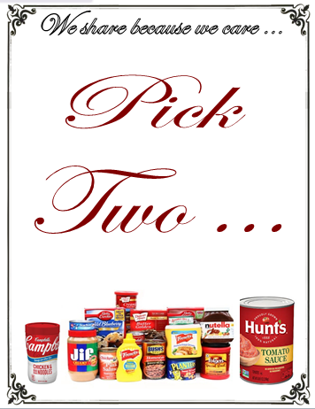
Set up cont. – Pick Two Table
The pick two table contain food items that
are nearing their expiration date. The visitor
can select two items from the table.

Slide 12
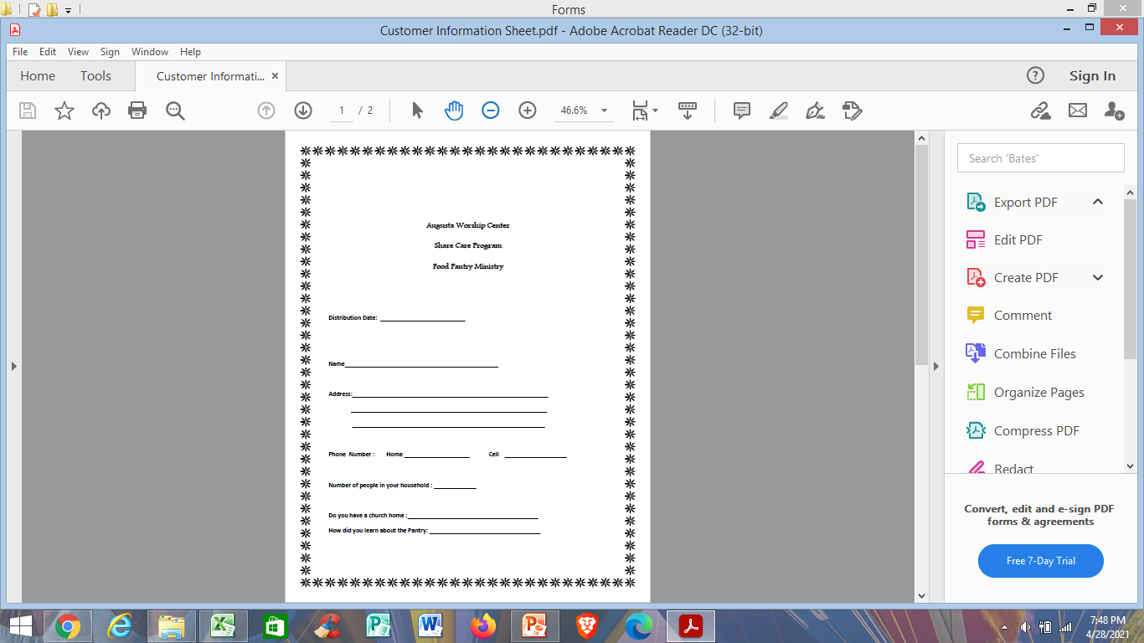
Recordkeeping
Use Food Card to gather client information
    Date of visit {needed to monitor
    frequency of pantry usage}
    Name
    Age
    Address
    Phone Number
    Number in Household- #Adult/#Children
    Church affiliation
*We do not ask for income amount, proof of individuals in a household or exclude according to residency; Just request: demographics, name, address, phone number and age group

Slide 13
Recordkeeping Cont.
Retain client info. for 1 year until yearly data can be compiled
Data needed to be tracked yearly:
  Total visitors served
  Number of visitors attending church service
  Food distributed
  Age of visitors that use facility to better their needs
Record monthly/quarterly pest control service
Track inventory and food distribution

Slide 14
Replenish the Pantry
How to Replenish the Food Pantry:
  Food drives within the church
  Grocery Store donations
  Discount store (i.e. Family Dollar, Dollar General..)
  Purchase from Food Bank
    EIN/Tax ID is needed to receive donations from certain stores so that provider can receive tax write off

Slide 15
Initial Goals
To operate every Tuesday and Friday evenings; church service nights
Have the ability to provide 2 meals per family
Set up a client choice pantry where the clients will pick out their food preferences (to avoid waste)

Slide 16
Future Goals
Expand the “AWC Cares” program to offer additional support to the community: scholarships, outreach events, and ministry support
Increase the meal selections to include fresh fruit & vegetables, meats, frozen foods, and etc.
Eventually provide clothing, shoes, toiletries, baby items and etc.
Standalone building

